Slide 1
Frost Seeded Brassica
SCS RA Team
Summer 2022
Musgrave research Farm

Slide 2
Brassica & Weed Biomass

Slide 3
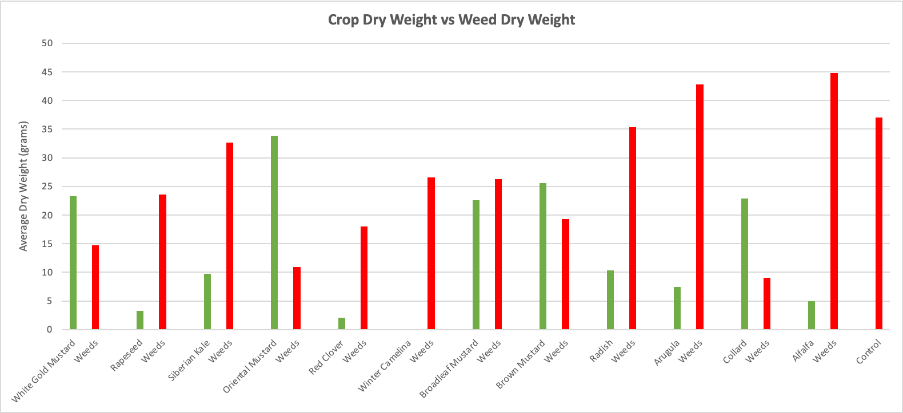

Slide 4
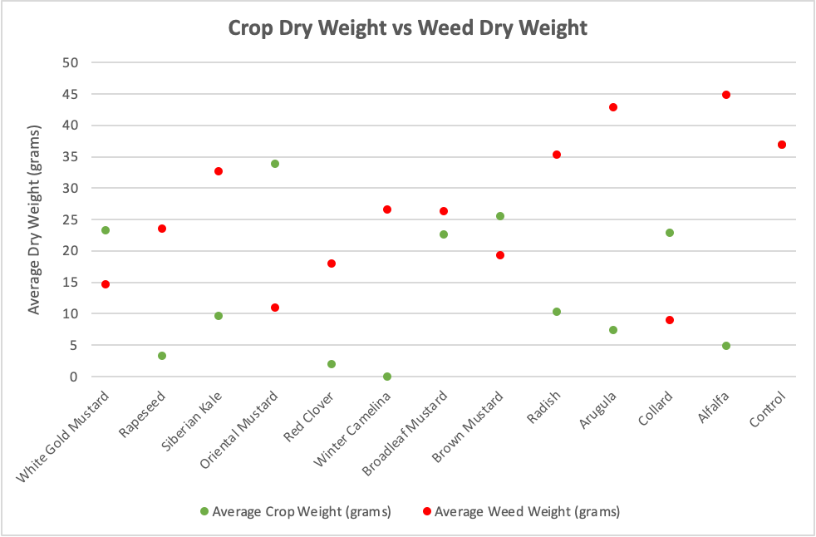

Slide 5
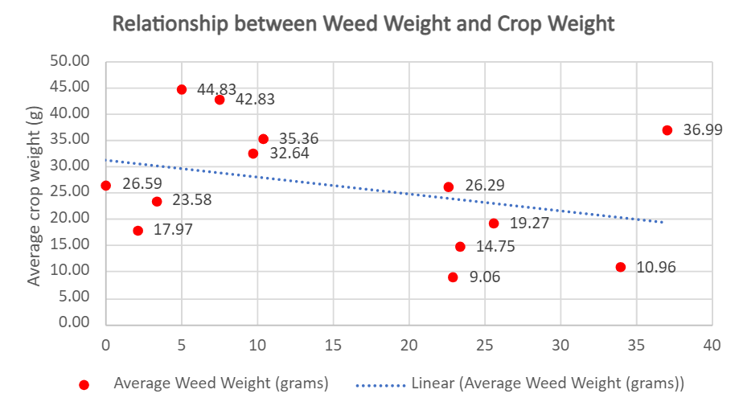

Slide 6
Percent Cover

Slide 7
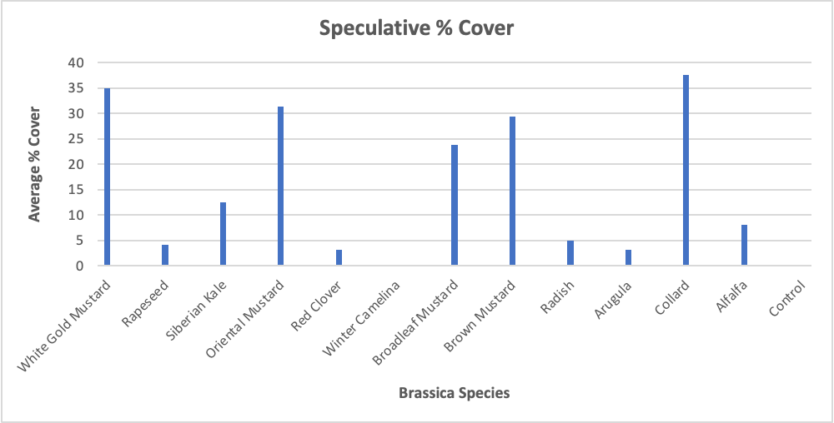

Slide 8
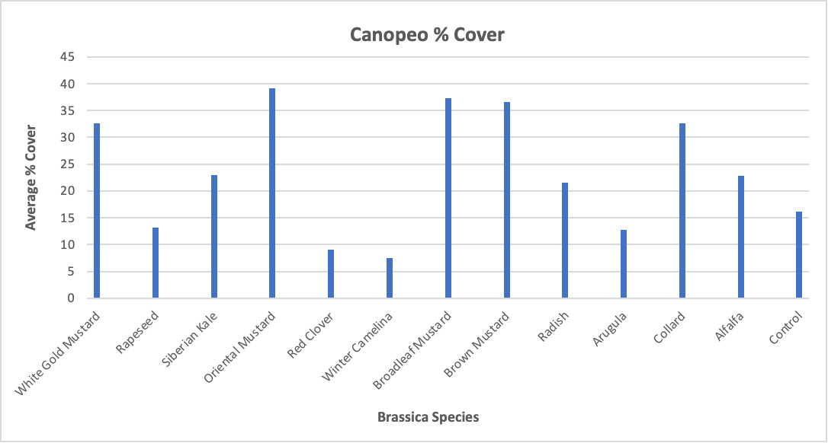

Slide 9
